Slide 1
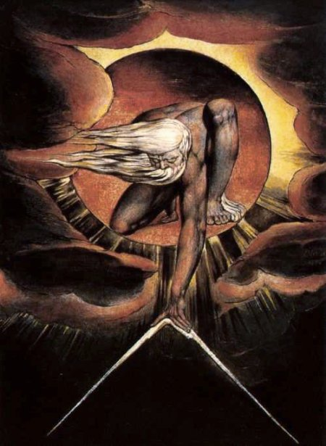
The Problem of Evil
PH1102E/GEK1067
Week 6

Slide 2
Plan for Today
I. Two conceptions of God
II. Theism, atheism, agnosticism
III. The Argument from Evil
IV. Varieties of evil
V. Defending theism against the Argument from Evil:
A. Free will defense
B. Contrast defense
C. Spiritual development defense
D. Unknown necessity defense
E. Less-evil-than-meets-the-eye defense

Slide 3
Conceptions of God
There is a “metaphysical” conception of God as an intelligent but largely impersonal power or presence.
Alternatively, there is a “personal” conception of God as a being that is not only intelligent and powerful, but also benevolent and interested in our welfare.

Slide 4
Conceptions of God
Not all personal conceptions of God are the same, but they all have some basic things in common. They are conceptions of a God who is:
(1) extraordinarily powerful
(2) extraordinarily knowledgeable
(3) interested in our welfare

Slide 5
Theism, Atheism, Agnosticism
When it comes to the question whether God exists, you have three options. You can...
...believe that God exists. (theist)
...believe that God does not exist. (atheist)
...neither believe that God exists nor believe that
God does not exist. (agnostic)

Slide 6
Theism, Atheism, Agnosticism
Today we consider an argument for atheism.
This is an attempt to prove that there is no extraordinarily powerful, extraordinarily knowledge-able being who cares about us.

Slide 7
The argument from evil

Slide 8
If there’s a God, why do so many bad things happen?

Slide 9
Bad Things
Bad things come in two varieties: moral evils and natural evils.

Slide 10
Moral Evils
Moral evils are bad things that result from wrongdoing.
Examples include...

Slide 11
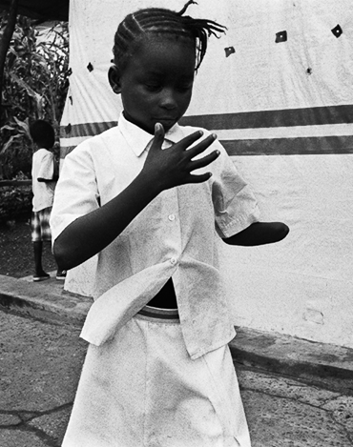
Moral Evils
The deliberate mutilation of children during the civil war in Sierra Leone.
About 20,000 civilians received such treatment during this conflict.

Slide 12
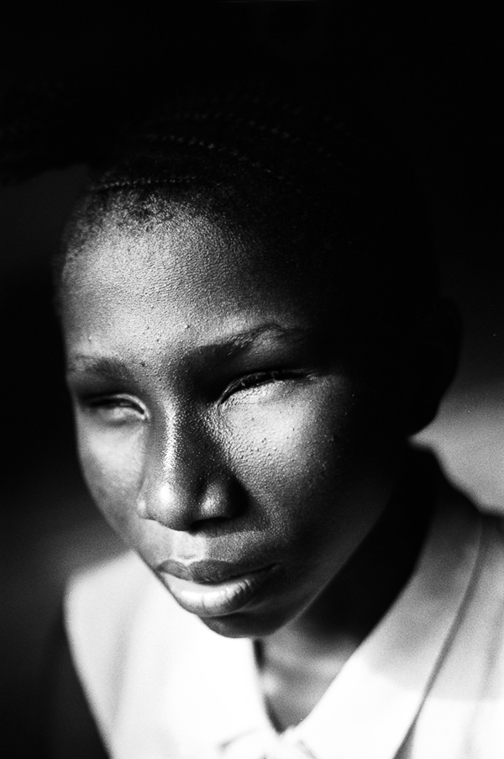
Moral Evils
The deliberate mutilation of children during the civil war in Sierra Leone.
About 20,000 civilians received such treatment during this conflict.

Slide 13
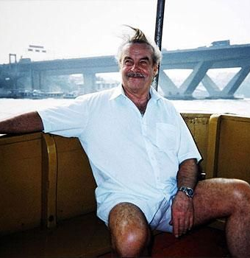
Moral Evils
Josef Fritzl, from Austria (seen here on vacation in Thailand).
He locked his teenage daughter in his tiny, windowless basement, where he kept her imprisoned for 24 years.

Slide 14
Moral Evils
He raped her repeatedly, fathering seven children. One died in the basement. Three he took out of the basement and “adopted.” The other three remained in the basement for years -- the oldest til he was 18.

Slide 15
Natural Evils
Natural evils are bad things that do not result from any wrongdoing.
Examples include...

Slide 16
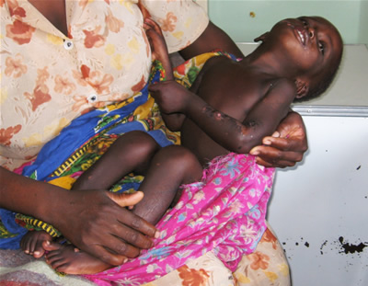
Natural Evils
...disease.
This child is dying of malaria. About 3,000 people die of malaria every day, 90% of them African, 85% under the age of 6.

Slide 17
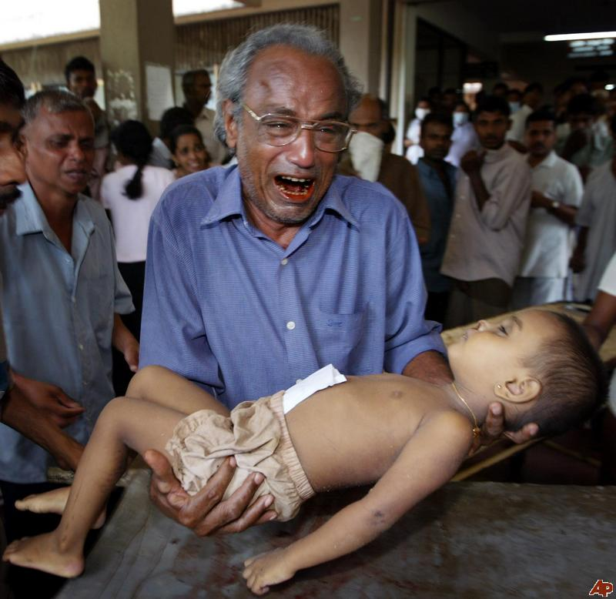
Natural Evils
Earthquakes and other natural disasters.
Here is one of the 230,000+ victims of the 2004 tsunami.

Slide 18
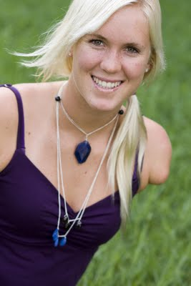
Natural Evils
Harms inflicted by non-human agents, such as sharks.
Notes:
Bethany Hamilton

Slide 19
The Argument from Evil
If God exists, there is no unnecessary evil.
There is unnecessary evil.
Therefore, God does not exist.

Slide 20
The Argument from Evil
If God exists, there is no unnecessary evil.
There is unnecessary evil.
Therefore, God does not exist.

Slide 21
The Argument from Evil
If God exists, there is no unnecessary evil.
There is unnecessary evil.
Therefore, God does not exist.
Today we consider 5 challenges to this claim.
They are:

Slide 22
that the evils of the world are a necessary side-effect of freedom of will
that the evils of the world are necessary for us to appreciate the good things about the world
that the evils of the world are necessary for our spiritual development
that the evils of the world are, for reasons we cannot grasp, necessary for the greater good
that the evil in this life is far less than meets the eye, and is necessary for our subsequent enlightenment.

Slide 23
The free will defense

Slide 24
The Free Will Defense
In order to create us as free beings, God has to endow us with wills over which even he has no control.
Unfortunately, some people exercise their freedom of will to do great harm.
This harm is the inevitable price of human freedom.

Slide 25
The Free Will Defense
The free will defense is a limited response to the Argument from Evil, since it only tries to reconcile the existence of moral evils with the existence of God.

Slide 26
The Free Will Defense
The free will defense assumes that we have free will; some philosophers deny this.
Some say that God could have given people free will, and at the same time pre-programmed people only to do good things with their freedom.
But, for the sake of argument, let’s assume that we are free in a radical, non-Humean way.
Does the free will defense succeed then?

Slide 27
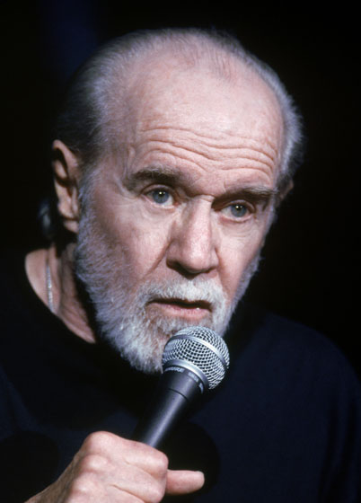
The Free Will Defense
If God gives us this radical freedom, why doesn’t he at least intervene to minimize the harm that results when people abuse it?

Slide 28
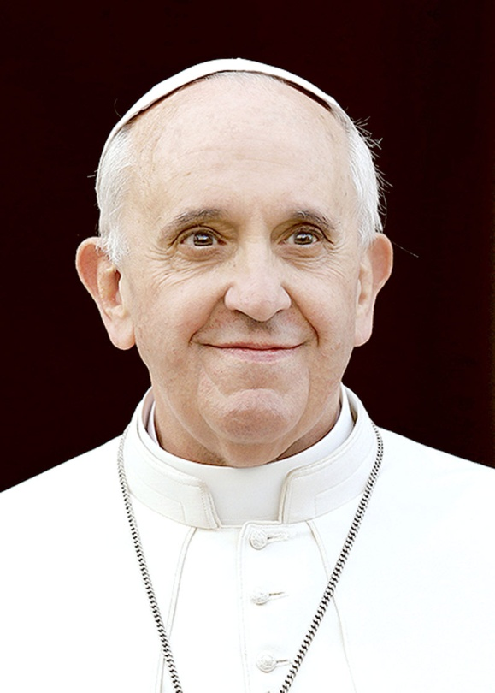
The Free Will Defense
If God always intervened that way, we would have no reason to take other people’s welfare into consideration when choosing what to do.
We would treat life like a video game.

Slide 29
The Free Will Defense
Well, what’s worse: having a bunch of people who treat life like a video game, or a bunch of people who burn out children’s eyes, rape their own daughters, and exterminate ethnic minorities?
If this is the cost of unsuper-vised freedom, it’s not worth the price.

Slide 30
that the evils of the world are a necessary side-effect of freedom of will
that the evils of the world are necessary for us to appreciate the good things about the world
that the evils of the world are necessary for our spiritual development
that the evils of the world are, for reasons we cannot grasp, necessary for the greater good
that the evil in this life is far less than meets the eye, and is necessary for our subsequent enlightenment.

Slide 31
The contrast defense

Slide 32

The Contrast Defense
We would not appreciate the good things in life unless we were exposed to bad things too.

Slide 33
The Contrast Defense
OK. But why do we need so much evil---moral as well as natural---in order to appreci-ate the good things in life?
And what about bad things that happen without anyone knowing?

Slide 34
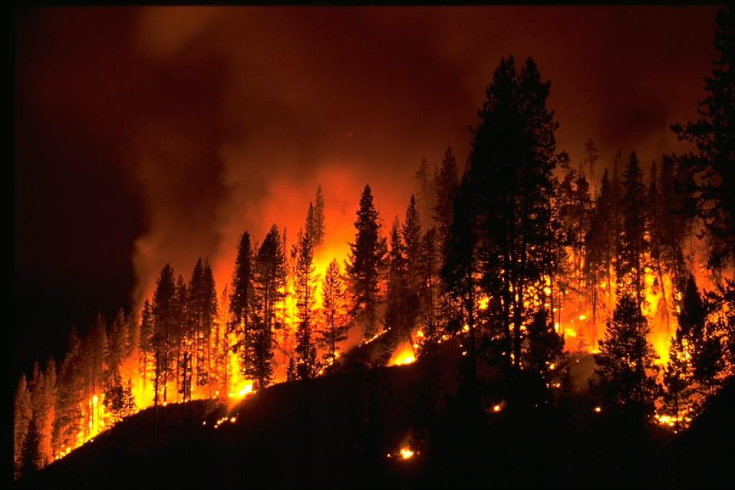

Slide 35
that the evils of the world are a necessary side-effect of freedom of will
that the evils of the world are necessary for us to appreciate the good things about the world
that the evils of the world are necessary for our spiritual development
that the evils of the world are, for reasons we cannot grasp, necessary for the greater good
that the evil in this life is far less than meets the eye, and is necessary for our subsequent enlightenment.

Slide 36
Spiritual development defense

Slide 37
Spiritual Development Defense
The reason why God allows evil to take place is that this evil is good for us.
A human being cannot realize his or her full spiritual potential without confronting some evil in (moral or natural).

Slide 38
Spiritual Development Defense
I agree that confronting evil can lead to spiritual development.
But too much evil can have the opposite effect.
Notes:
Victims of abuse becoming abusers…little children dying before they can learn any lessons from the evils they confront…

Slide 39
Spiritual Development Defense
Furthermore, if the point of suffering is that it promotes spiritual development, then why is it that some spiritually under-developed people never suffer at all---or at least, not enough to promote spiritual development?

Slide 40
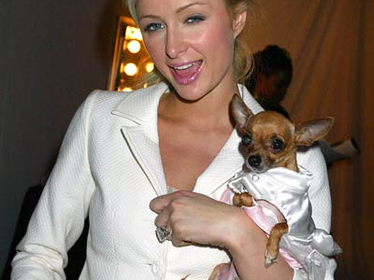
Notes:
Are rich people less in need of spiritual development than poor people?

Slide 41
that the evils of the world are a necessary side-effect of freedom of will
that the evils of the world are necessary for us to appreciate the good things about the world
that the evils of the world are necessary for our spiritual development
that the evils of the world are, for reasons we cannot grasp, necessary for the greater good
that the evil in this life is far less than meets the eye, and is necessary for our subsequent enlightenment.

Slide 42
Unknown necessity defense

Slide 43
Unknown Necessity
It is true that we cannot see how a loving, powerful, and wise God could let all these bad things happen.
But maybe that is just because we have a limited point of view...

Slide 44
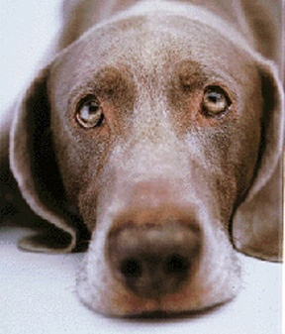
Unknown Necessity
A dog cannot understand why its master takes it to the veterinarian for its shots.
From the dog’s limited point of view, nothing good at all comes of the innoculation--- it’s just pure, pointless pain...

Slide 45
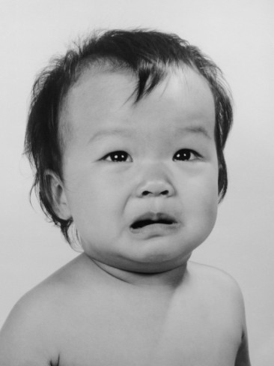
Unknown Necessity
The same is true of a small child. The child cannot understand why its parents let the doctor stick it with a needle.
From the child’s limited point of view, nothing good comes of the innoculation at all---it is pure, pointless suffering...

Slide 46
Unknown Necessity
Well, maybe we are to God as the dog is to its master, and as the child is to its parents.
Maybe all these horrible things that happen are somehow all for the best, even though we can’t see how.

Slide 47
Unknown Necessity
If God only allows evils that are necessary for the greater good, then shouldn’t we be grateful for all the evils of our world? Shouldn’t we thank God for letting innocent people get raped and mutilated, little kids die from cancer, and forest animals suffer painful fiery deaths?

Slide 48
that the evils of the world are a necessary side-effect of freedom of will
that the evils of the world are necessary for us to appreciate the good things about the world
that the evils of the world are necessary for our spiritual development
that the evils of the world are, for reasons we cannot grasp, necessary for the greater good
that the evil in this life is far less than meets the eye, and is necessary for our subsequent enlightenment.

Slide 49
that the evils of the world are a necessary side-effect of freedom of will
that the evils of the world are necessary for us to appreciate the good things about the world
that the evils of the world are necessary for our spiritual development
that the evils of the world are, for reasons we cannot grasp, necessary for the greater good
that the evil in this life is far less than meets the eye, and is necessary for our subsequent enlightenment.

Slide 50
Less-evil-than-meets-the-eye defense

Slide 51
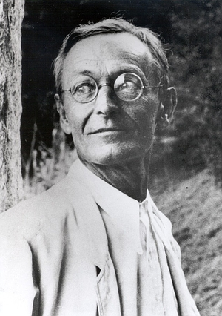
Less Evil than Meets the Eye
Maybe this life is a dream, or, as the case may be, a nightmare.
Maybe what we call “death” is an awakening from this dream.
And maybe we wake up wiser, better, and happier people for having had the bad dream.
Hermann Hesse
(1877-1962)
Notes:
A very ancient idea that we find in both Eastern and Western civilization and philosophy.

Slide 52


Slide 53
Less Evil than Meets the Eye
OK, I have to admit that’s a great story.
But why should I believe it?
Isn’t this just wishful thinking?

Slide 54
Less Evil than Meets the Eye
You call it wishful thinking.
I call it faith.

Slide 55
End of lecture.

Slide 56
Weekly Assignment #5
For this assignment, complete the multiple choice quiz posted on IVLE.
Word limit: NA
Upload by 8:00pm, Thursday 2 October.

